Slide 1



GenAI Multilingual Translator
An AI-powered language translator with voice and auto-detection features.
Presented By- SRISHTI

Slide 2

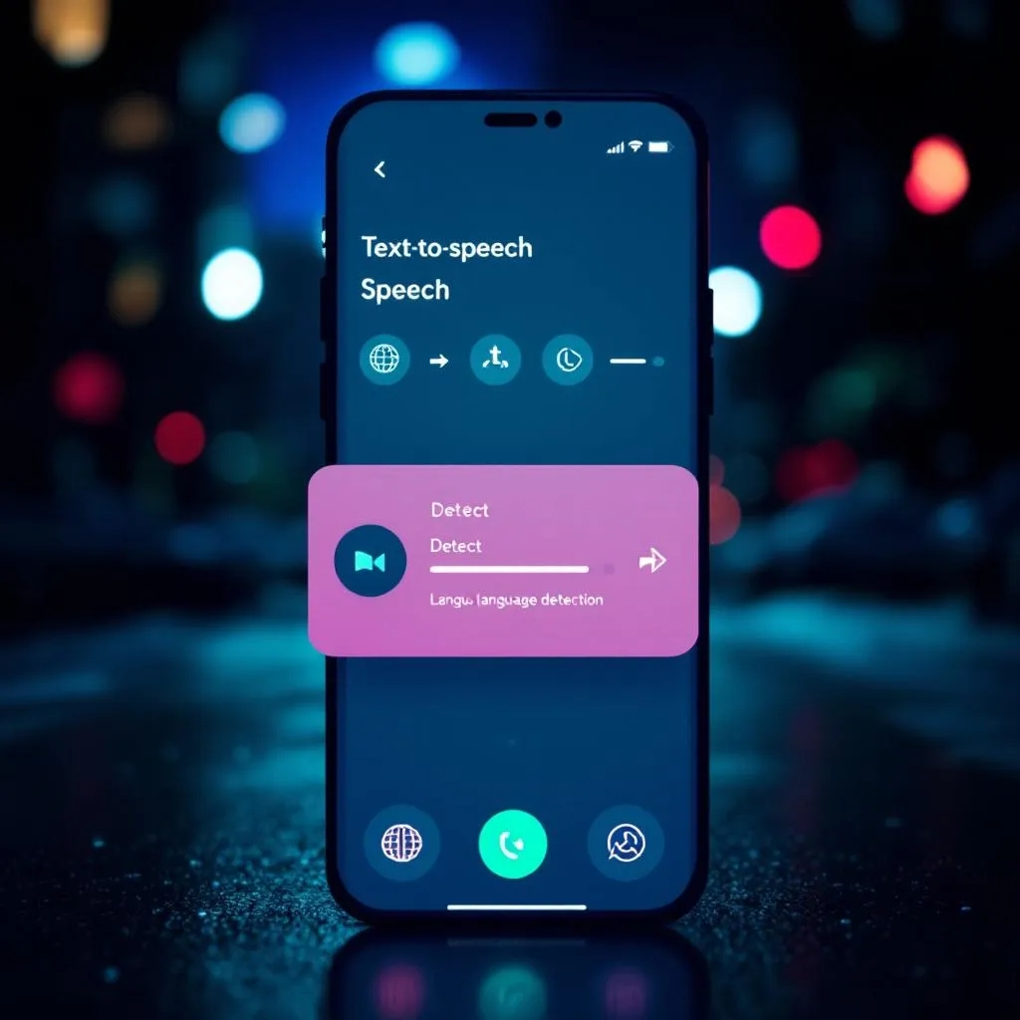
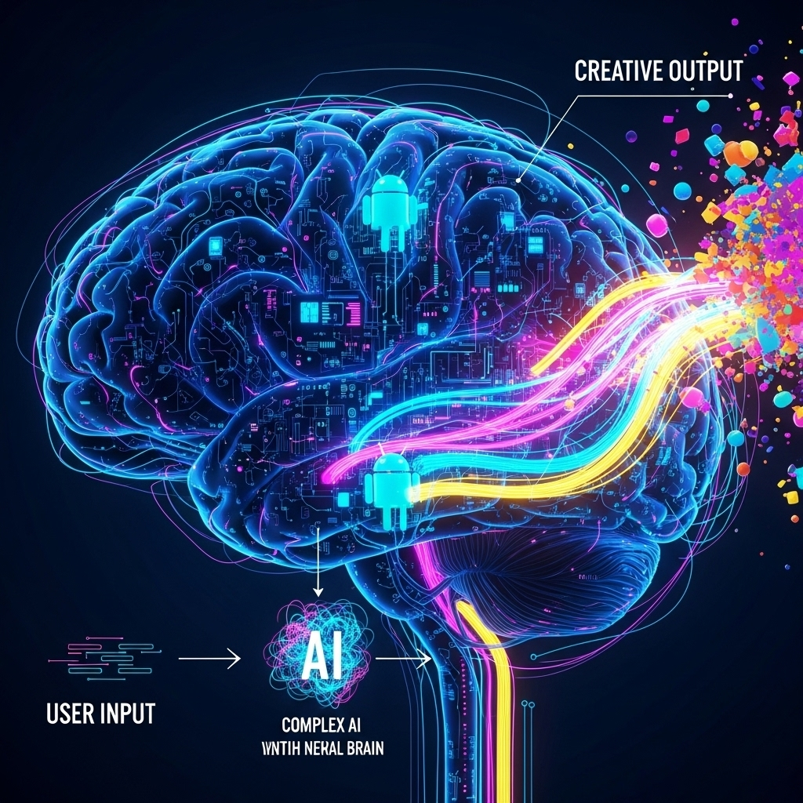
OVERVIEW:
The GenAI Multilingual Translator is an innovative web application designed for seamless text translation across over 200 languages. Leveraging cutting-edge AI models, it offers voice output, automatic language detection, and a user-friendly interface for an intuitive translation experience.
BUILD WITH:
Python for robust backend logic
Gradio for interactive UI development
Hugging Face Transformers for advanced NMT
gTTS for natural voice output
langdetect for precise language identification
Custom HTML & CSS for aesthetic design

Slide 3
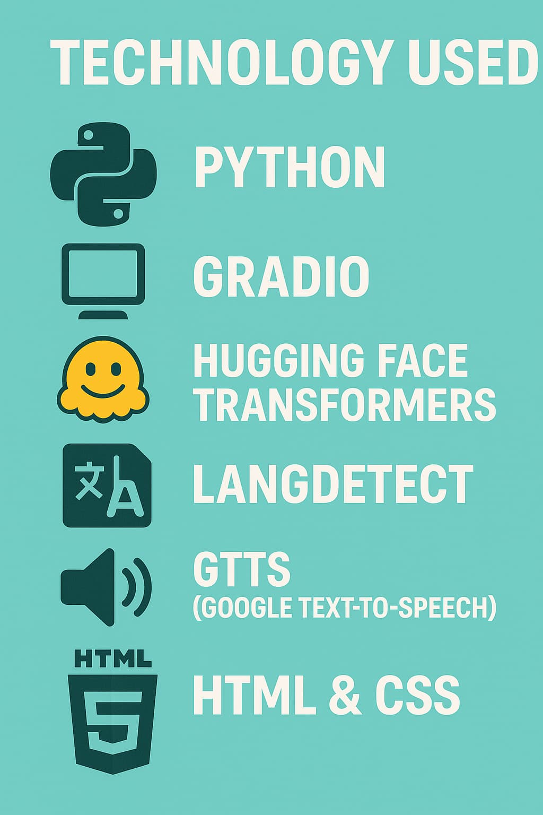
Tech Stack🛠️:
Python – Core logic and integration
Gradio – User interface for input/output
Hugging Face Transformers – Translation using Facebook/nllb-200-distilled-600M
langdetect – For automatic detection of input language
gTTS (Google Text-to-Speech) – Converts translated text into speech
HTML & CSS – Custom styling and UI design

Slide 4

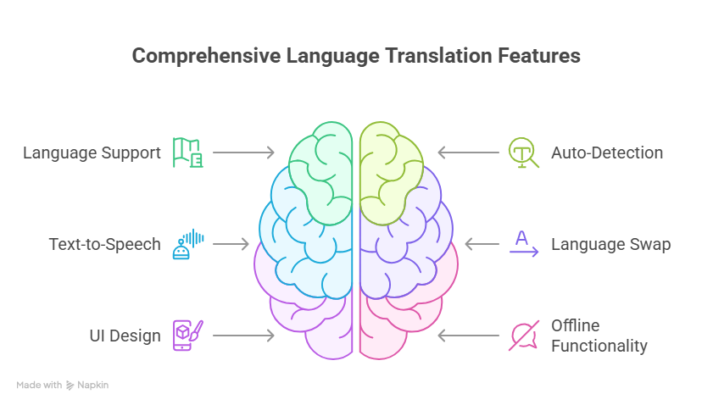

Key Features:
1
🌍 Translate across 200+ languages
2
🧠 Auto-detect source language
3
🎤 Text-to-Speech (audio output using gTTS)
4
🔁 Swap source and target languages
5
🖥️ Clean, responsive user interface with gradient background
6
📦 No external APIs – works offline with local models

Slide 5
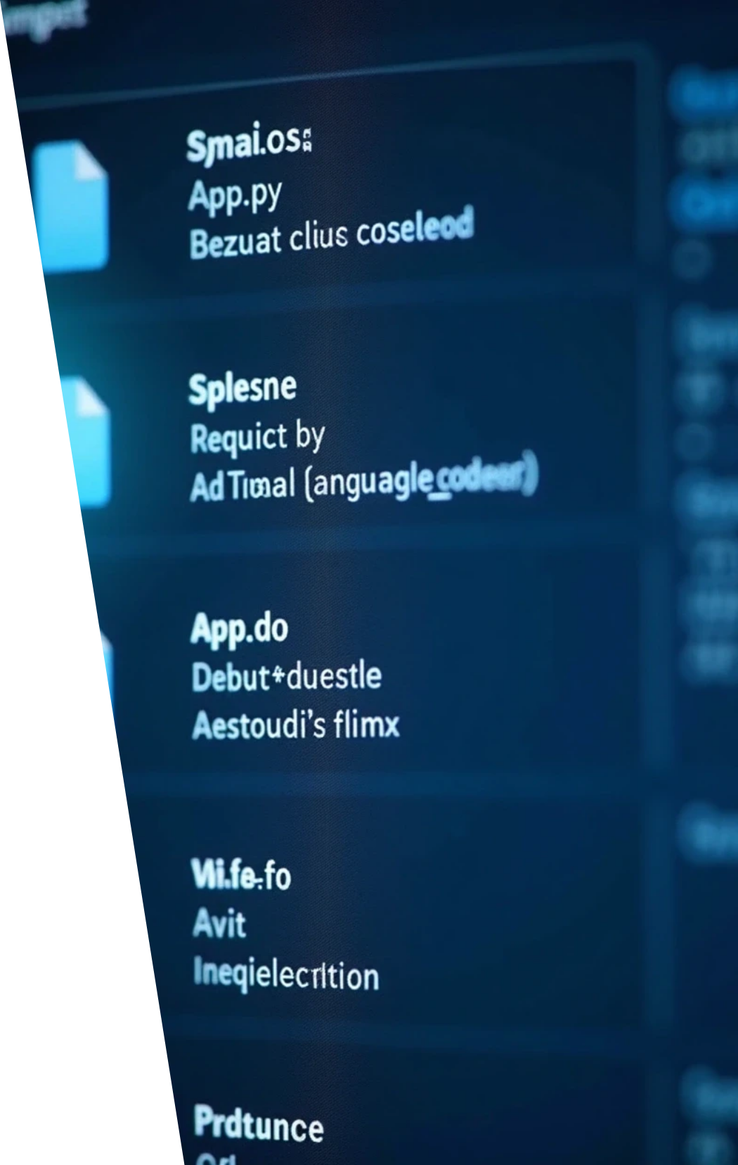
Project Structure:
📦 AI_TRANSLATOR_PROJECT
┣ 📁 static
┃ ┣ 📜 styles.css
┣ 📜 app.py
┣ 📜 requirements.txt
┣ 📜 language_codes.json
# Custom CSS for styling
# Main Python app (Gradio interface)
# All dependencies
# Mapping of language names to NLLB codes

Slide 6

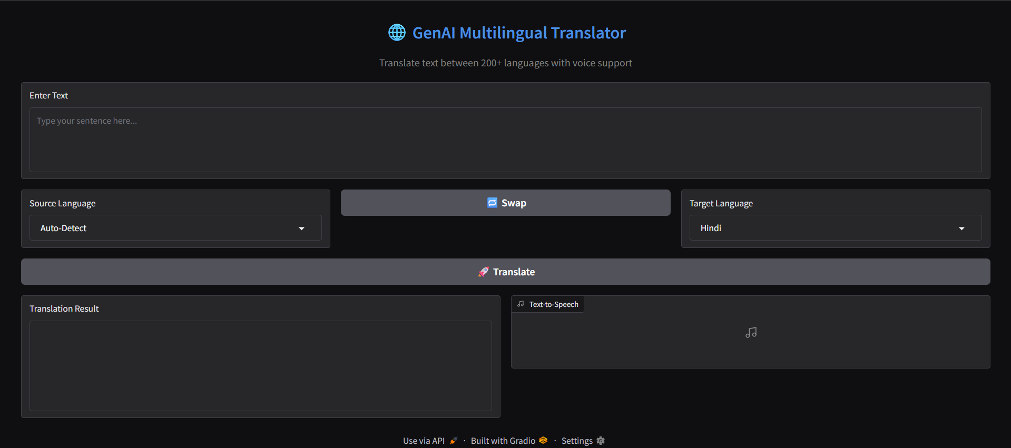
UI HIGHLIGHTS:
🎨 Custom gradient background
📂 Interactive dropdowns for language selection
🔁 Swap button to change direction of translation
✍️ Input & Output text areas
🔊 Play button for audio output (gTTS)

Slide 7

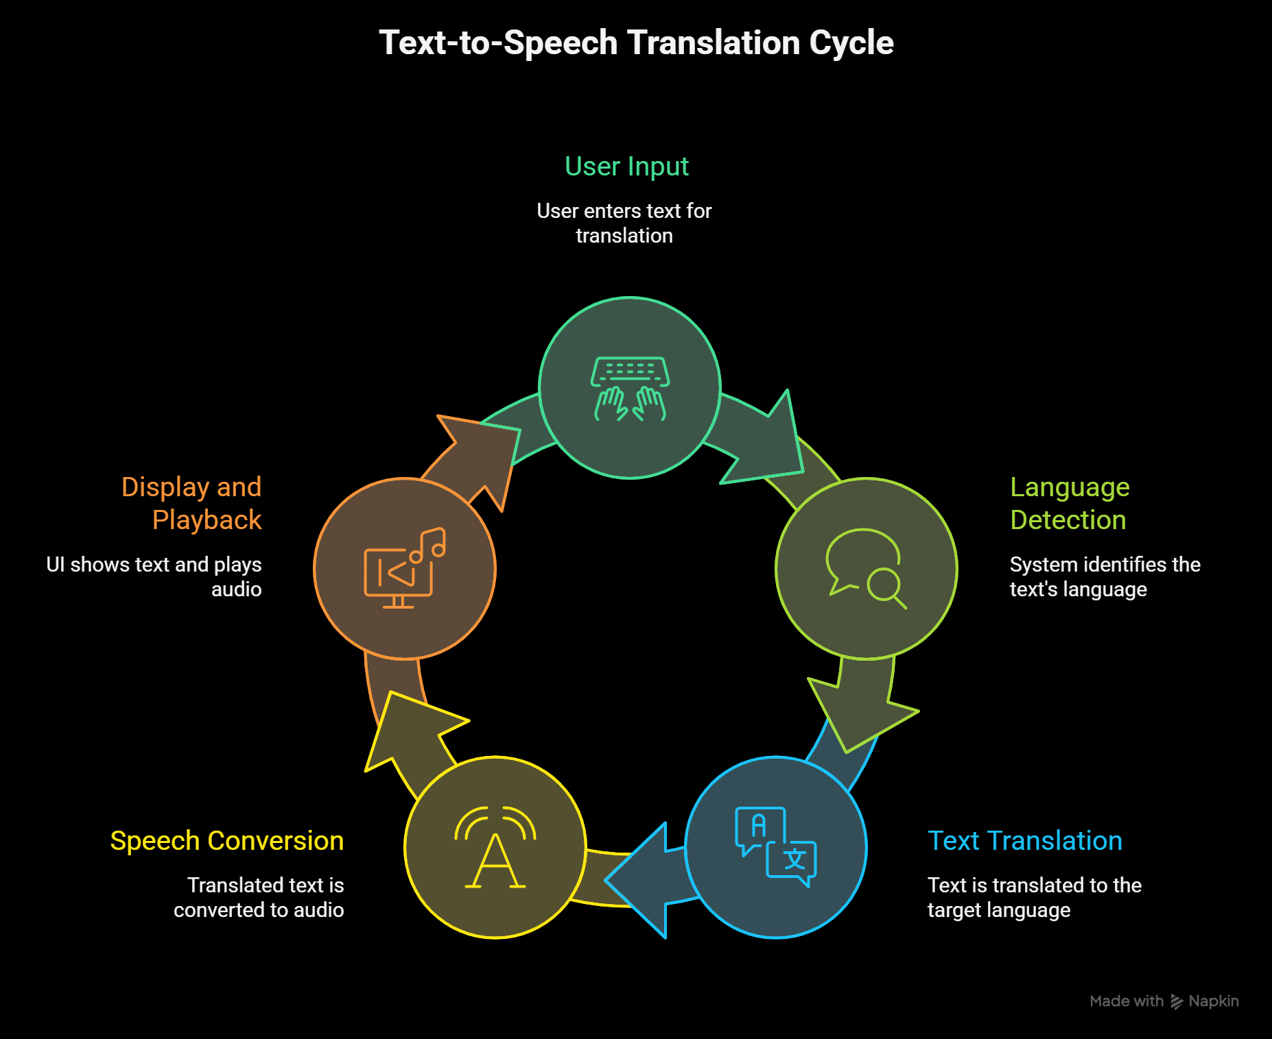
HOW IT WORKS

Slide 8

CHALLENGES FACED:
1
Integrating Gradio with custom CSS
2
Image paths and file structuring
3
Getting gTTS to support multiple languages
4
Language detection accuracy

Slide 9




WHAT I LEARNED:
Working with Hugging Face models
Handling language code mapping (FLORES-200)
Frontend & backend integration in Python projects
Debugging static file issues in Gradio

Slide 10

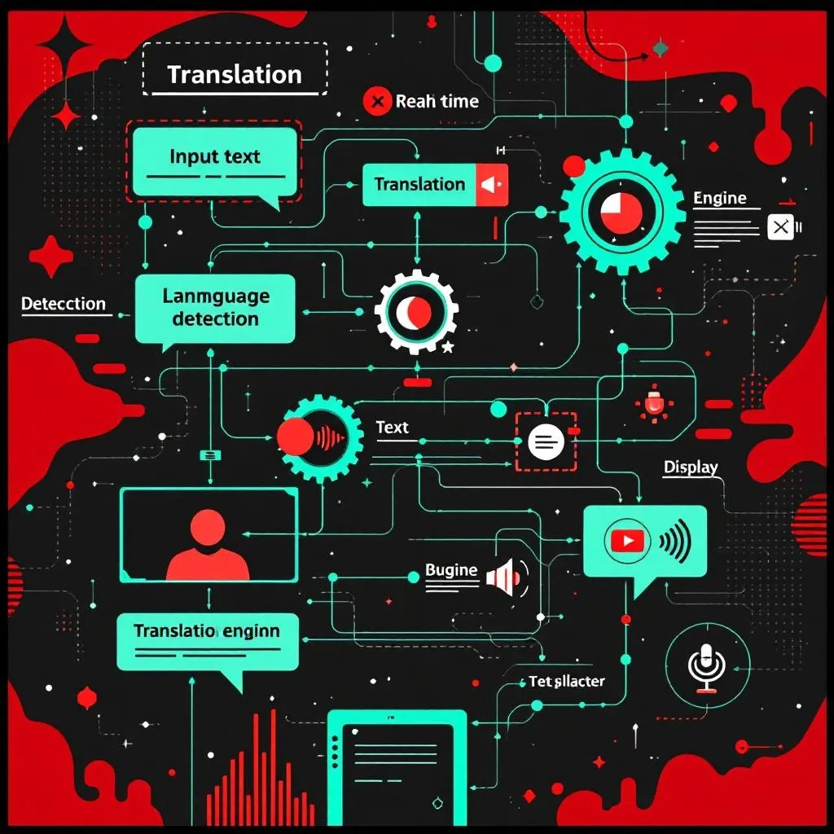
FUTURE ENHANCEMENTS:
Add confidence score for language detection
Integrate Speech-to-Text (STT) using Whisper
Deploy app on Hugging Face Spaces or Render
Include illustration images or animated logo

Slide 11


Thank You

